Slide 1
We have had a recall!
Gibson received some improperly treated wood and is recalling some Les Paul models. Our product # 2 is one of the models.

Slide 2
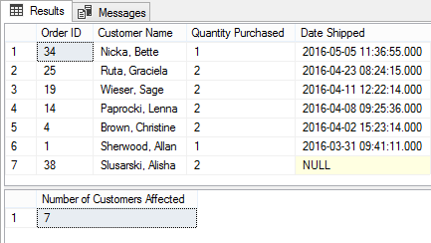
Product ID 2
List of all customers that have purchased this product

Slide 3
Product ID 2
How many customers are affected?

Slide 4
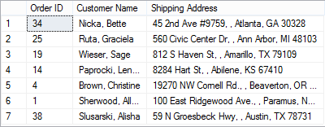
Product ID 2
List of mailing addresses of affected customers

Slide 5
Product ID 2
List of the total amount spent by customers on this product

